Slide 1
Advanced Database Systems
Chapter 2
Transaction Processing Concepts

Slide 2
What is a transaction?
A Transaction is a mechanism for applying the desired modifications/operations to a database.
Action, or series of actions, carried out by a single user or application program, which accesses or changes contents of database. (i.e. Logical unit of work on the database.)
A transaction could be a whole program, part/module of a program or a single command.
Changes made in real time to a database are called transactions.
Examples include ATM transactions, credit card approvals, flight reservations, hotel check-in, phone calls, supermarket canning, academic registration and billing.

Slide 3
…Con’t
A transaction could be composed of one or more database and non-database operations.
Transforms database from one consistent state to another, although consistency may be violated during transaction.
A database transaction is a unit of interaction with database management system or similar system that is treated in a coherent and reliable way independent of other transactions.

Slide 4
Transaction Processing System
A system that manages transactions and controls their access to a DBMS is called a TP monitor.
A transaction processing system (TPS) generally consists of a TP monitor, one or more DBMSs, and a set of application programs containing transaction.
In database field, a transaction is a group of logical operations that must all succeed or fail as a group.
Systems dedicated to supporting such operations are known as transaction processing systems.

Slide 5
…con’t
Distinction between business transactions and online transactions:
A business transaction is an interaction in the real world, usually between an enterprise and a person, where something is exchanged. Example : market
An online transaction is the execution of a program that performs an administrative or real-time function, often by accessing shared data sources, usually on behalf of an online user (although some transactions are run offline in batch).

Slide 6
…con’t
Transactions can be started, attempted, then committed or aborted via data manipulation commands of SQL.
Can have one of the two outcomes for any transaction:
Success - transaction commits and database reaches a new consistent state
Committed transaction cannot be aborted or rolled back.
Failure - transaction aborts, and database must be restored to consistent state before it started.
Such a transaction is rolled back or undone.
Aborted transaction that is rolled back can be restarted later.

Slide 7
…con’t
The DBMS has no inherent way of knowing the logical grouping of operations that are supposed to be done together.
Hence, it must provide the users a means to logically group their operations.
Key words such as BEGIN TRANSACTION, COMMIT and ROLLBACK (or their equivalents) are available in many data manipulation languages to delimit transactions.
A single transaction might require several queries, each reading and/or writing information in the database.
When this happens it is usually important to be sure that the database is not left with only some of the queries carried out.
For example, when doing a money transfer, if the money was debited from one account, it is important that it also be credited to the depositing account.
Also, transactions should not interfere with each other

Slide 8
Properties of Transaction
A transaction is expected to exhibit some basic features or properties to be considered as a valid transaction.
These features are:
A: Atomicity
C: Consistency
I: Isolation
D: Durability
It is referred to as ACID property of a transaction.
Without the ACID property, the integrity of the database cannot be guaranteed.

Slide 9
Atomicity
Is All or None property
Every transaction should be considered as an atomic process which cannot be sub divided into small tasks.
Due to this property, just like an atom which exists or does not exist, a transaction has only two states.
Done or Never Started.
Done - a transaction must complete successfully and its effect should be visible in the database.
Never Started - If a transaction fails during execution then all its modifications must be undone to bring back the database to the last consistent state, i.e., remove the effect of failed transaction.
No state between Done and Never Started

Slide 10
Consistency
If the transaction code is correct then a transaction, at the end of its execution, must leave the database consistent.
A transaction should transform a database from one previous consistent state to another consistent state.
Isolation
A transaction must execute without interference from other concurrent transactions and its intermediate or partial modifications to data must not be visible to other transactions.

Slide 11
Durability
The effect of a completed transaction must persist in the database,
i.e., its updates must be available to other transaction immediately after the end of its execution, and is should not be affected due to failures after the completion of the transaction.
In practice, these properties are often relaxed somewhat to provide better performance.

Slide 12
Transaction Support
No explicit Begin Transaction statement
Transaction initiation is done implicitly when particular SQL statements are encountered.
Every transaction must have an explicit end statement
COMMIT
ROLLBACK
Every transaction has certain characteristics attributed to it.
These characteristics are specified by a SET TRANSACTION statement in SQL.
The characteristics are
the access mode
the diagnostic area size
the isolation level.
Access mode is READ ONLY or READ WRITE
Diagnostic area size option
Integer value indicating number of conditions held simultaneously in the diagnostic area

Slide 13
Transaction Support …con’t
Isolation level option
Dirty read
Nonrepeatable read
Phantoms
Dirty read A transaction T1 may read the update of a transaction T2, which has not yet committed. If T2 fails and is aborted, then T1 would have read a value that does not exist and is incorrect.
Nonrepeatable read transaction T1 may read a given value from a table. If another transaction T2 later updates that value and T1 reads that value again, T1 will see a different value.
Phantoms A transaction T1 may read a set of rows from a table, perhaps based on some condition specified in the SQL WHERE-clause. Now suppose that a transaction T2 inserts a new row that also satisfies the WHERE-clause condition used in T1, into the table used by T1. If T1 is repeated, then T1 will see a phantom, a row that previously did not exist.
Notes:
Dirty read. A transaction T1 may read the update of a transaction T2, which has not yet committed. If T2 fails and is aborted, then T1 would have read a value that does not exist and is incorrect.
Nonrepeatable read transaction T1 may read a given value from a table. If another transaction T2 later updates that value and T1
reads that value again, T1 will see a different value.
Phantoms. A transaction T1 may read a set of rows from a table, perhaps based on some condition specified in the SQL WHERE-clause. Now suppose that a transaction T2
inserts a new row that also satisfies the WHERE-clause condition used in T1, into the table used by T1.If T1 is repeated, then T1 will see a phantom, a row that previously did not exist.

Slide 14
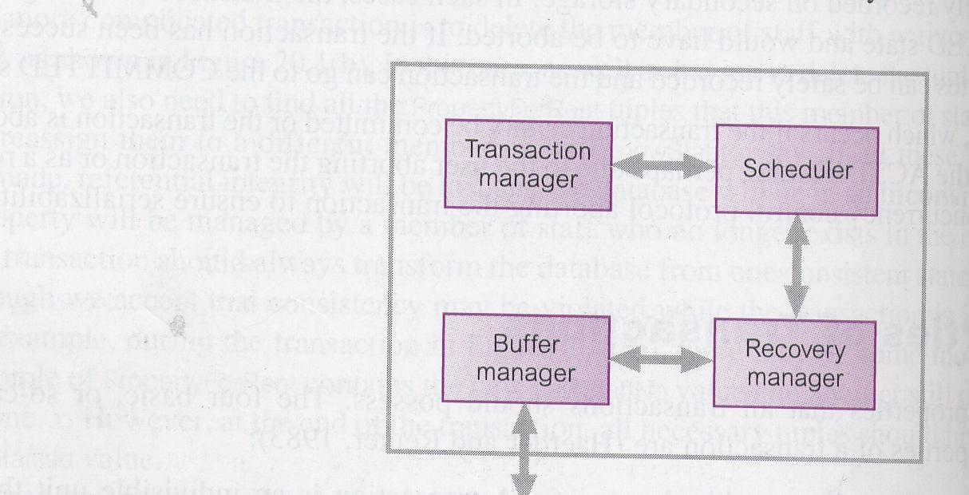
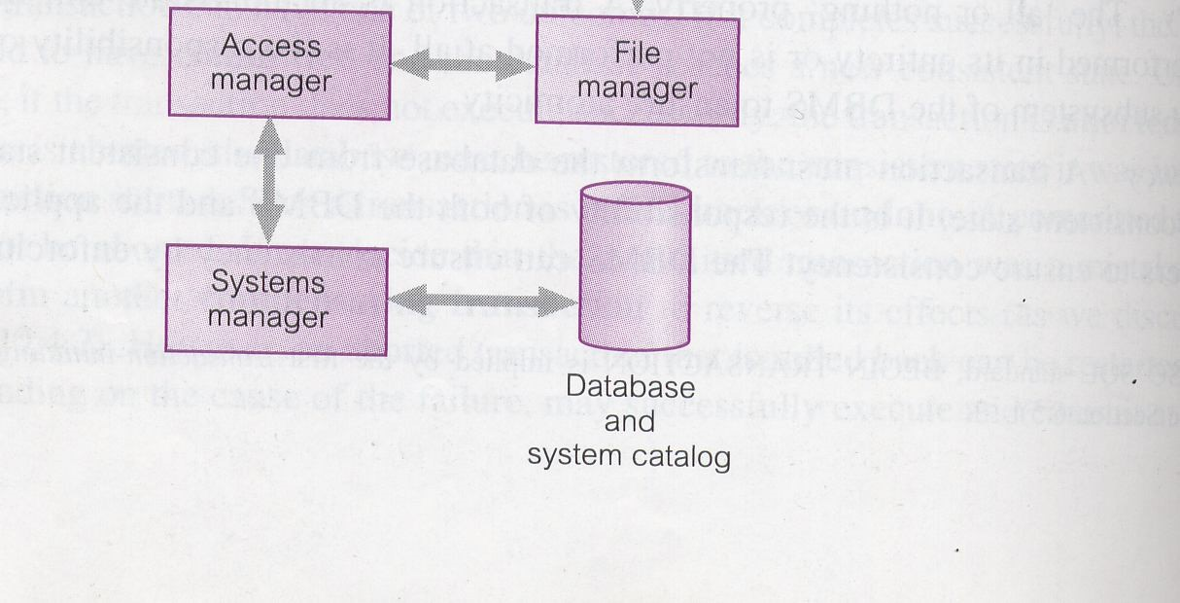
…con’t
The transaction sub system of a DBMS is depicted in the following.
of
the transaction sub system
Fig.
the DBMS

Slide 15
Transaction and System Concepts
System must keep track of when each transaction starts, terminates, commits, and/or aborts
BEGIN_TRANSACTION
READ or WRITE
END_TRANSACTION
COMMIT_TRANSACTION
ROLLBACK (or ABORT)

Slide 16
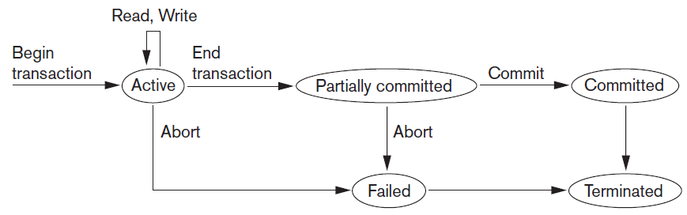
Transaction and System Concepts (cont’d.)
Figure 2.4 State transition diagram illustrating the states for transaction execution

Slide 17
State of a Transaction
A transaction is an atomic operation from the users’ perspective. But it has a collection of operations and it can have a number of states during its execution.
A transaction can end in three possible ways.
Successful Termination: when a transaction completes the execution of all operations in it and reaches the COMMIT command.
Suicidal Termination: when the transaction detects an error during its processing and decide to quick itself before the end of the transaction and perform a ROLL BACK
Murderous Termination: When the DBMS or the system force the execution to abort for any reason. And hence, rolled back.

Slide 18
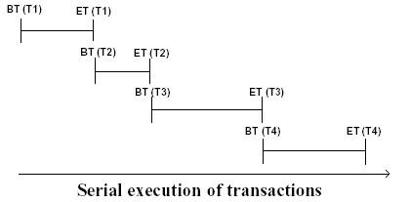
Ways of Transaction Execution
There are two ways of executing a set of transactions:
(a) Serially: Serial Execution: In a serial execution transactions are executed strictly serially.
Thus, Transaction Ti completes and writes its results to the database then only the next transaction T_{j} is scheduled for execution.
This means at one time there is only one transaction is being executed in the system.
The data is not shared between transactions at one specific time.

Slide 19
...con’t
In Serial transaction execution, one transaction being executed does not interfere the execution of any other transaction.
Good things about serial execution
Correct execution, i.e., if the input is correct then output will be correct.
Fast execution, since all the resources are available to the active.
The worst thing about serial execution is very inefficient resource utilization. i.e. reduced parallelism.
Notations:
Read(x) →read data item x from database
Write(x) →write data item x into the database

Slide 20
…con’t
Example of a serial execution
Suppose data items X = 10, Y = 6, and N =1 and T₁ and T₂ are transactions.
Final values of X, Y at the end of T₁ and T₂:
X = 12 and Y = 7.
Thus in serial execution of transaction, if we have two transactions T_{i} and T_{i+1}, then T_{i+1} will only be executed after the completion of Ti.
Time | T₁ | T₂
 | read (X) {X = 10}
 | X := X+N {X = 11}
 | write (X) {X = 11}
 | read (Y) {Y = 6}
 | Y := Y+N {Y = 7}
 | write (Y) {Y = 7}
 |  | read (X) {X = 11}
 |  | X := X+N {X = 12}
 |  | write (X)
T₁ | T₂
read (X) | read (X)
X := X+N | X := X+N
write (X) | write (X)
read (Y)
Y := Y+N
write (Y)

Slide 21
…con’t
(b) Concurrently: is the reverse of serially executable transactions,
In this scheme the individual operations of transactions, i.e., reads and writes are interleaved in some order.
Final values at the end of T₁ and T₂: X = 11, and Y = 7.
This improves resource utilization, unfortunately gives incorrect result.
The correct value of X is 12 but in concurrent execution X =11, which is incorrect.
The reason for this error is incorrect sharing of X by T₁ and T₂.
Time | T₁ | T₂
 | read (X) {X = 10}
 |  | read (X) {X = 10}
 | X := X+N {X = 11}
 |  | X := X+N {X = 11}
 | write (X) {X = 11}
 |  | write (X) (X=11)
 | read (Y) {Y = 6}
 | Y := Y+N {Y = 7}
 | write (Y) {Y = 7}

Slide 22
…con’t
In serial execution
T₂ read the value of X written by T₁ (i.e., 11)
In concurrent execution
T₂ read the same value of X (i.e., 10) as T₁ did and the update made by T₁ was overwritten by T₂’s update.
This is the reason the final value of X is one less than what is produced by serial execution.
But, why concurrent execution? Reasons:
Many systems have an independent component to handle I/O like DMA (Direct Memory Access) module.
CPU may process other transactions while one is in I/O operation
Improves resource utilization
Increases the throughput of the system.

Slide 23
Problems Associated with Concurrent Transaction Processing
Two transactions may be correct when inserting of operations may produce an incorrect result which needs control over access.
Having a concurrent transaction processing, one can enhance the throughput of the system.
As reading and writing is performed from and on secondary storage, the system will not be idle during these operations if there is a concurrent processing.
Every transaction is correct when executed alone.
The three potential problems caused by concurrency are:
Lost Update Problem
Uncommitted Dependency Problem
Inconsistent Analysis Problem.

Slide 24
Lost Update Problem
Successfully completed update on a data set by one transaction is overridden by another transaction/user.
E.g. Account with balance A=100.
T₁ reads the account A
T₁ withdraws 10 from A
T₁ makes the update in the Database
T₂ reads the account A
T₂ adds 100 on A
T₂ makes the update in the Database
In the above case, if done one after the other (serially) then we have no problem.
If the execution is T₁ followed by T₂ then A=190
If the execution is T₂ followed by T₁ then A=190

Slide 25
…con’t
But if they start at the same time in the following sequence:
T₁ reads the account A=100
T₁ withdraws 10 making the balance A=90
T₂ reads the account A=100
T₂ adds 100 making A=200
T₁ makes the update in the Database A=90
T₂ makes the update in the Database A=200
After the successful completion of the operation in this schedule, the final value of A will be 200 which override the update made by the first transaction that changed the value from 100 to 90.

Slide 26
Uncommitted Dependency Problem
Occurs when one transaction can see intermediate results of another transaction before it is committed.
E.g.
T₂ increases 100 making it 200 but then aborts the transaction before it is committed.
T₁ gets 200, subtracts 10 and make it 190. But the actual balance should be 90

Slide 27
Inconsistent Analysis Problem
Occurs when transaction reads several values but second transaction updates some of them during execution and before the completion of the first.
As discussed above, the objective of Concurrency Control Protocol is to schedule transactions in such a way as to avoid any interference between them.
This demands a new principle in transaction processing, which is serializability of the schedule of execution of multiple transactions.
Related with the inconsistent analysis problem we have the phantom read and the fuzzy(unclear) read problems

Slide 28
Serializability
In any transaction processing system, if concurrent processing is implemented, there will be concept called schedule having or determining the execution sequence of operations in different transactions.
Schedule: time-ordered sequence of the important actions taken by one or more transitions.
Schedule represents the order in which instructions are executed in the system in chronological ordering.
The scheduler component of a DBMS must ensure that the individual steps of different transactions preserve consistency.

Slide 29
…con’t
1) Serial Schedule: a schedule where the operations of each transaction are executed consecutively without any interleaved operations from other transactions.
2) Non-serial Schedule: Schedule where operations from a set of concurrent transactions are interleaved.
The objective of serializability is to find non-serial schedules that allow transactions to execute concurrently without interfering with one another.
If a non serial schedule can come up with a result equivalent to some serial schedule, we call the schedule Serializable.
Sequence of the execution of the operations will result in a value identical with serially executed transaction, which always is correct.
Serializability identifies those concurrent executions of transactions guaranteed to ensure consistency.

Slide 30
Serialization
Objective of serialization is to find schedules that allow transactions to execute concurrently without interfering with one another.
If two transactions only read data, order is not important.
If two transactions either read or write completely separate data items, they do not conflict and order is not important.
If one transaction writes a data item and another reads or writes the same data item, order of execution is important
Possible solution: Run all transactions serially.
This is often too restrictive as it limits degree of concurrency or parallelism in system.

Slide 31
Test for Serializability
Constrained write rule: transaction updates data item based on its old value, which is first read by the transaction.
Under the constrained write rule we can use precedence graph to test for serializability.
A non serial schedule can be tasted for serializability by using a method called precedence graph.
A precedence graph is composed of:
Nodes to represent the transactions, and
Arc(directed edge) to connect nodes indicating the order of execution for the transactions
So that the directed edge Ti→T_{j} implies, in an equivalent serial execution T_{i} must be executed before T_{j}.

Slide 32
The rules of precedence graph:
Represent each transaction in the schedule with a node.
Then draw a directed arc from T_{i} to T_{j} (that is T_{i} →to T_{j} ) if:
T_{j} Reads an item that is already Written by T_{i}
T_{i} Write(x) Then T_{j} Read(x)
T_{j} Writes an item that already has been Read by T_{i}, or
T_{i} Read(x) Then T_{j} Write(x)
T_{j} Writes an item that already has been Written by T_{i}
T_{i} Write(x) Then T_{j} Write(x)
After drawing the precedence graph, if there is any cycle in the graph, the schedule is said to be Non Serializable.
Otherwise, if there is no cycle in the graph, the schedule is equivalent with some serial schedule and is serializable

Slide 33
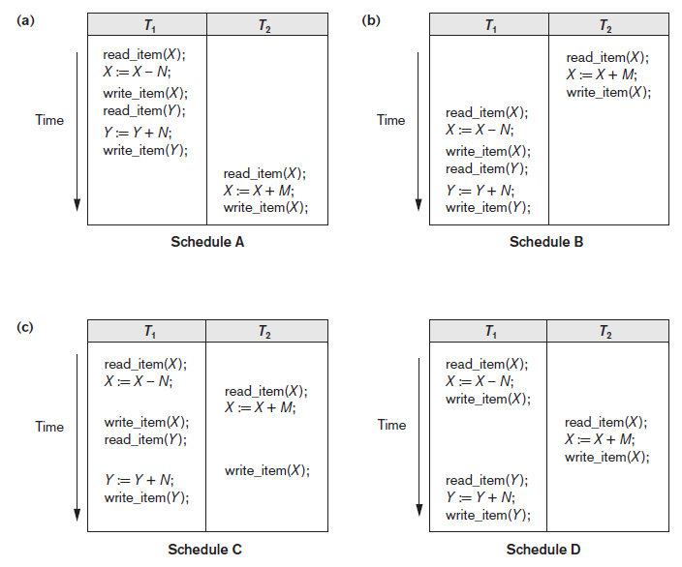
Figure 2.5 Examples of serial and nonserial schedules involving transactions T1 and T2 (a) Serial schedule A: T1 followed by T2 (b) Serial schedule B: T2 followed by T1 (c) Two nonserial schedules C and D with interleaving of operations

Slide 34
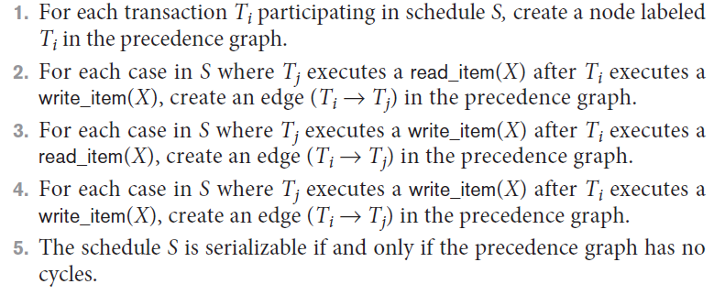
Characterizing Schedules Based on Serializability
Testing for serializability of a schedule
Algorithm 2.1 Testing conflict serializability of a schedule S

Slide 35
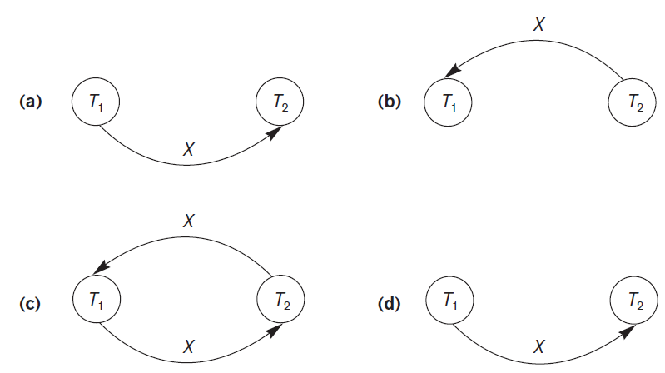
Characterizing Schedules Based on Serializability (cont’d.)
Figure 2.7 Constructing the precedence graphs for schedules A to D from Figure 20.5 to test for conflict serializability (a) Precedence graph for serial schedule A (b) Precedence graph for serial schedule B (c) Precedence graph for schedule C (not serializable) (d) Precedence graph for schedule D (serializable, equivalent to schedule A)

Slide 36
Exercise
Ex1:
R1(x) W2(x) W1(x)
Check: T₁→T₂ and T₂→T₁
Ex2:
R1(x)W2(x)W1(x)W3(x)
Check: T₁→T₂, T₂→T₁, T₂→T₃, T₃→T₂, T₁→T₃, and T₃→T₁

Slide 37


